Slide 1


Slide 2

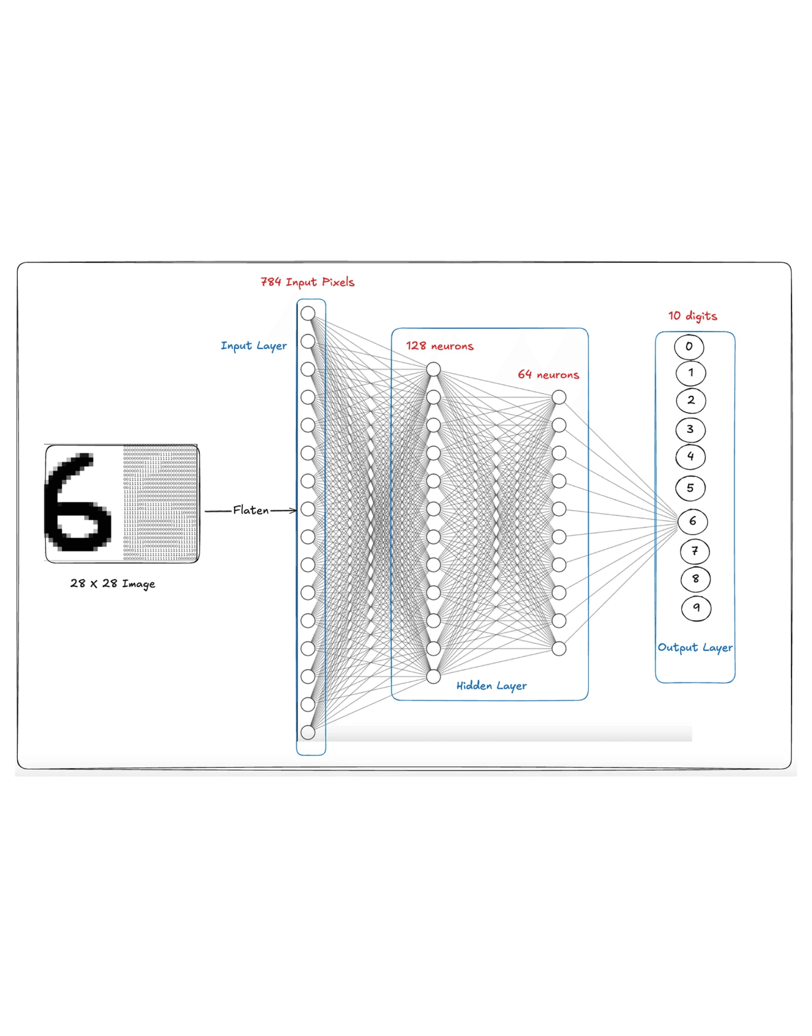
Handwritten Digit Recognition
A Comparative Analysis of Classification Algorithms
Graduate-Level Machine Learning Project

Slide 3

Project Overview & Objectives
Objective
Key Models Explored
Implement and compare multiple machine learning approaches for recognizing handwritten digits, focusing on accuracy, efficiency, and model robustness.
Multi-Layer Perceptron
Logistic Regression
Relevance
Linear Regression (OvA)
Handwritten digit recognition is a fundamental problem in computer vision with critical applications in postal automation, bank check processing, and automated data entry systems.
Naive Bayes (GaussianNB)

Slide 4
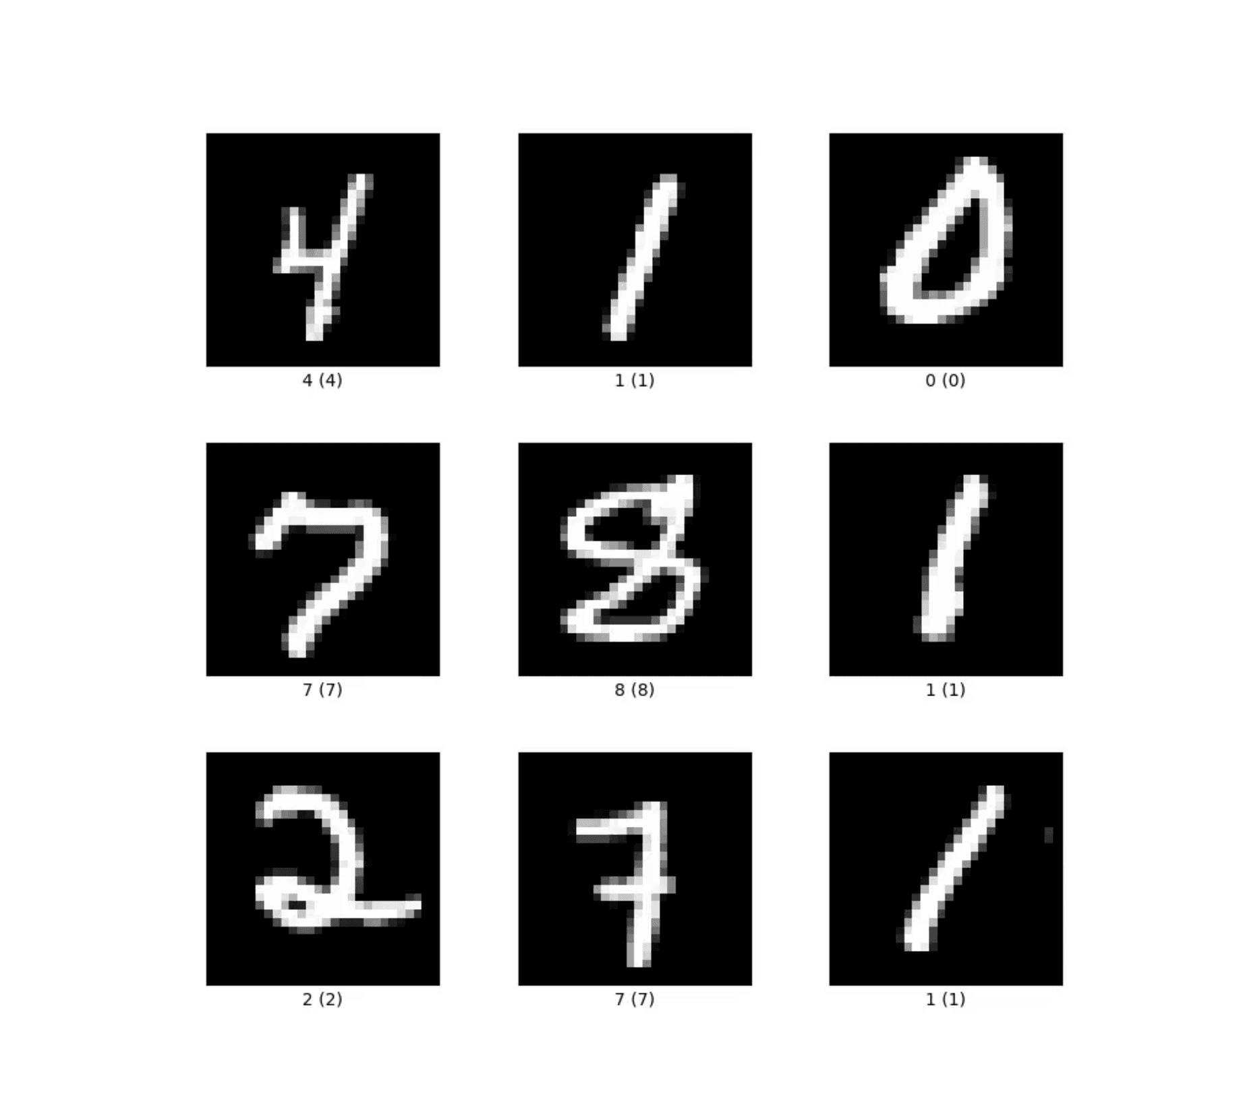
Dataset: DIDA 10K Version
Dataset Size
10,000 samples of handwritten digits
Input Format
28x28 pixel grayscale images
Representation
Flattened 784-dimensional vectors
Output Classes
10 classes (digits 0 through 9)
Source: didadataset.github.io/DIDA/

Slide 5
Methodology: Data Preprocessing
Normalization
Data Splitting
Validation
Pixel values were scaled to the [0, 1] range. This ensures numerical stability and facilitates faster convergence during the model training phase.
The dataset was divided into an 80% Training Set (8,000 samples) for optimization and a 20% Testing Set (2,000 samples) for final evaluation.
Implemented 5-fold Cross-Validation to ensure model robustness. This technique provides a more reliable estimate of model performance on unseen data.

Slide 6

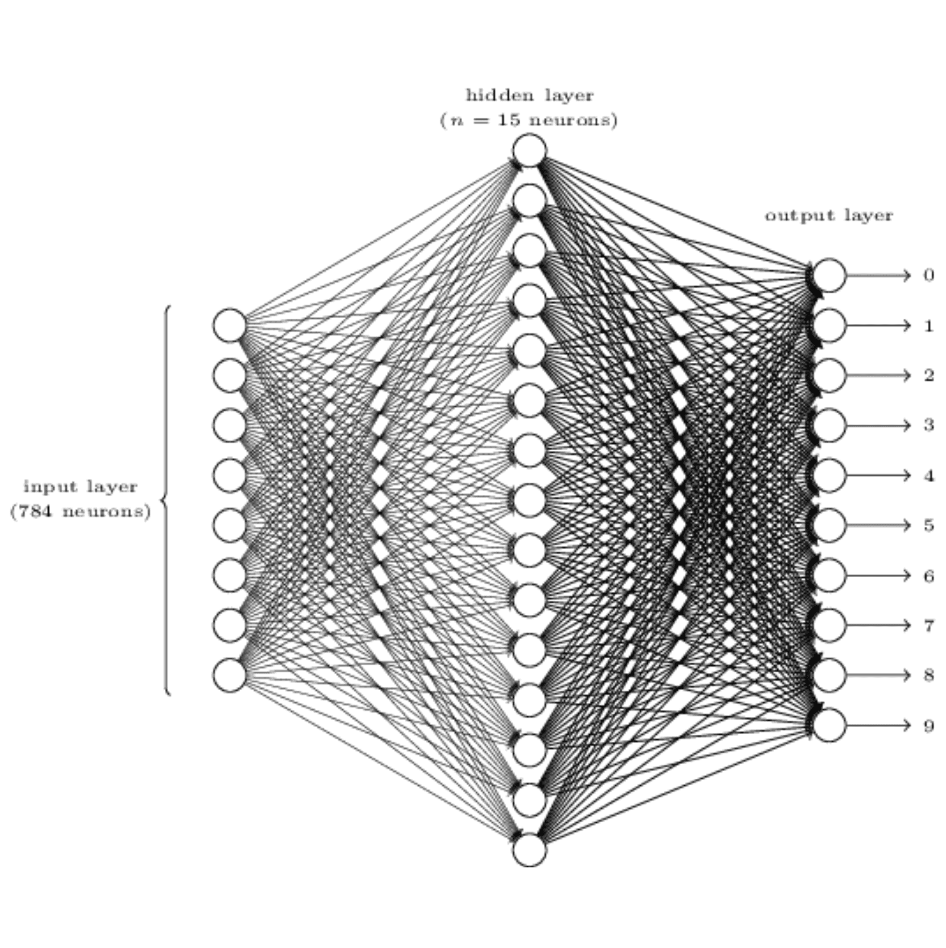
Methodology: Multi-Layer Perceptron (MLP)
Architecture
A feed-forward neural network consisting of an input layer (784 neurons), a minimum of two hidden layers with optimized neuron counts, and a 10-neuron output layer.
Optimization
Hyperparameters including learning rate, batch size, and number of epochs were tuned using iterative optimization to minimize classification error on the training set.
Key Strength: Capable of capturing complex non-linear relationships in high-dimensional pixel data through hierarchical feature learning.

Slide 7
Methodology: Regression Models
Logistic Regression
Linear Regression (OvA)
Multi-class Setup
One-vs-All Strategy
Implemented using a multinomial probabilistic approach to handle the 10-digit classification task directly.
Adapted for classification by training 10 separate binary linear models, each identifying one specific digit against all others.
Optimization
Focused on convergence criteria and L2 regularization to ensure model stability and prevent overfitting on high-dimensional pixel data.
Decision Logic
Predictions are made by selecting the class whose corresponding model yields the highest confidence score for the input vector.

Slide 8
Methodology: Naive Bayes Classifier
Probabilistic Approach
Implementation
Role as Baseline
Based on Bayes' Theorem, this model calculates the probability of a digit class given the observed pixel intensities. It assumes that each pixel's value is independent of others, simplifying the complex joint probability distribution.
The Gaussian Naive Bayes (GaussianNB) variant was selected for this project. It assumes that the continuous pixel intensity values for each class follow a normal (Gaussian) distribution.
Serves as a performance baseline to quantify the gains achieved by more complex discriminative models like Logistic Regression and Multi-Layer Perceptrons. It highlights the necessity of capturing spatial dependencies in digit recognition.
Key Assumption
Feature Independence: Despite being
"naive" in image data where pixels are
highly correlated, it provides a fast and
efficient baseline.

Slide 9

Results: Performance Metrics Summary
Model
Accuracy
Precision
Recall
F1-Score
MLP Neural Network
0.841
0.849
0.841
0.841
Logistic Regression
0.747
0.747
0.747
0.746
Linear Regression (OvA)
0.689
0.689
0.689
0.687
Naive Bayes
0.514
0.543
0.514
0.516
* Metrics evaluated on the 20% test set (2,000 samples). Highlighting indicates the top-performing model.

Slide 10

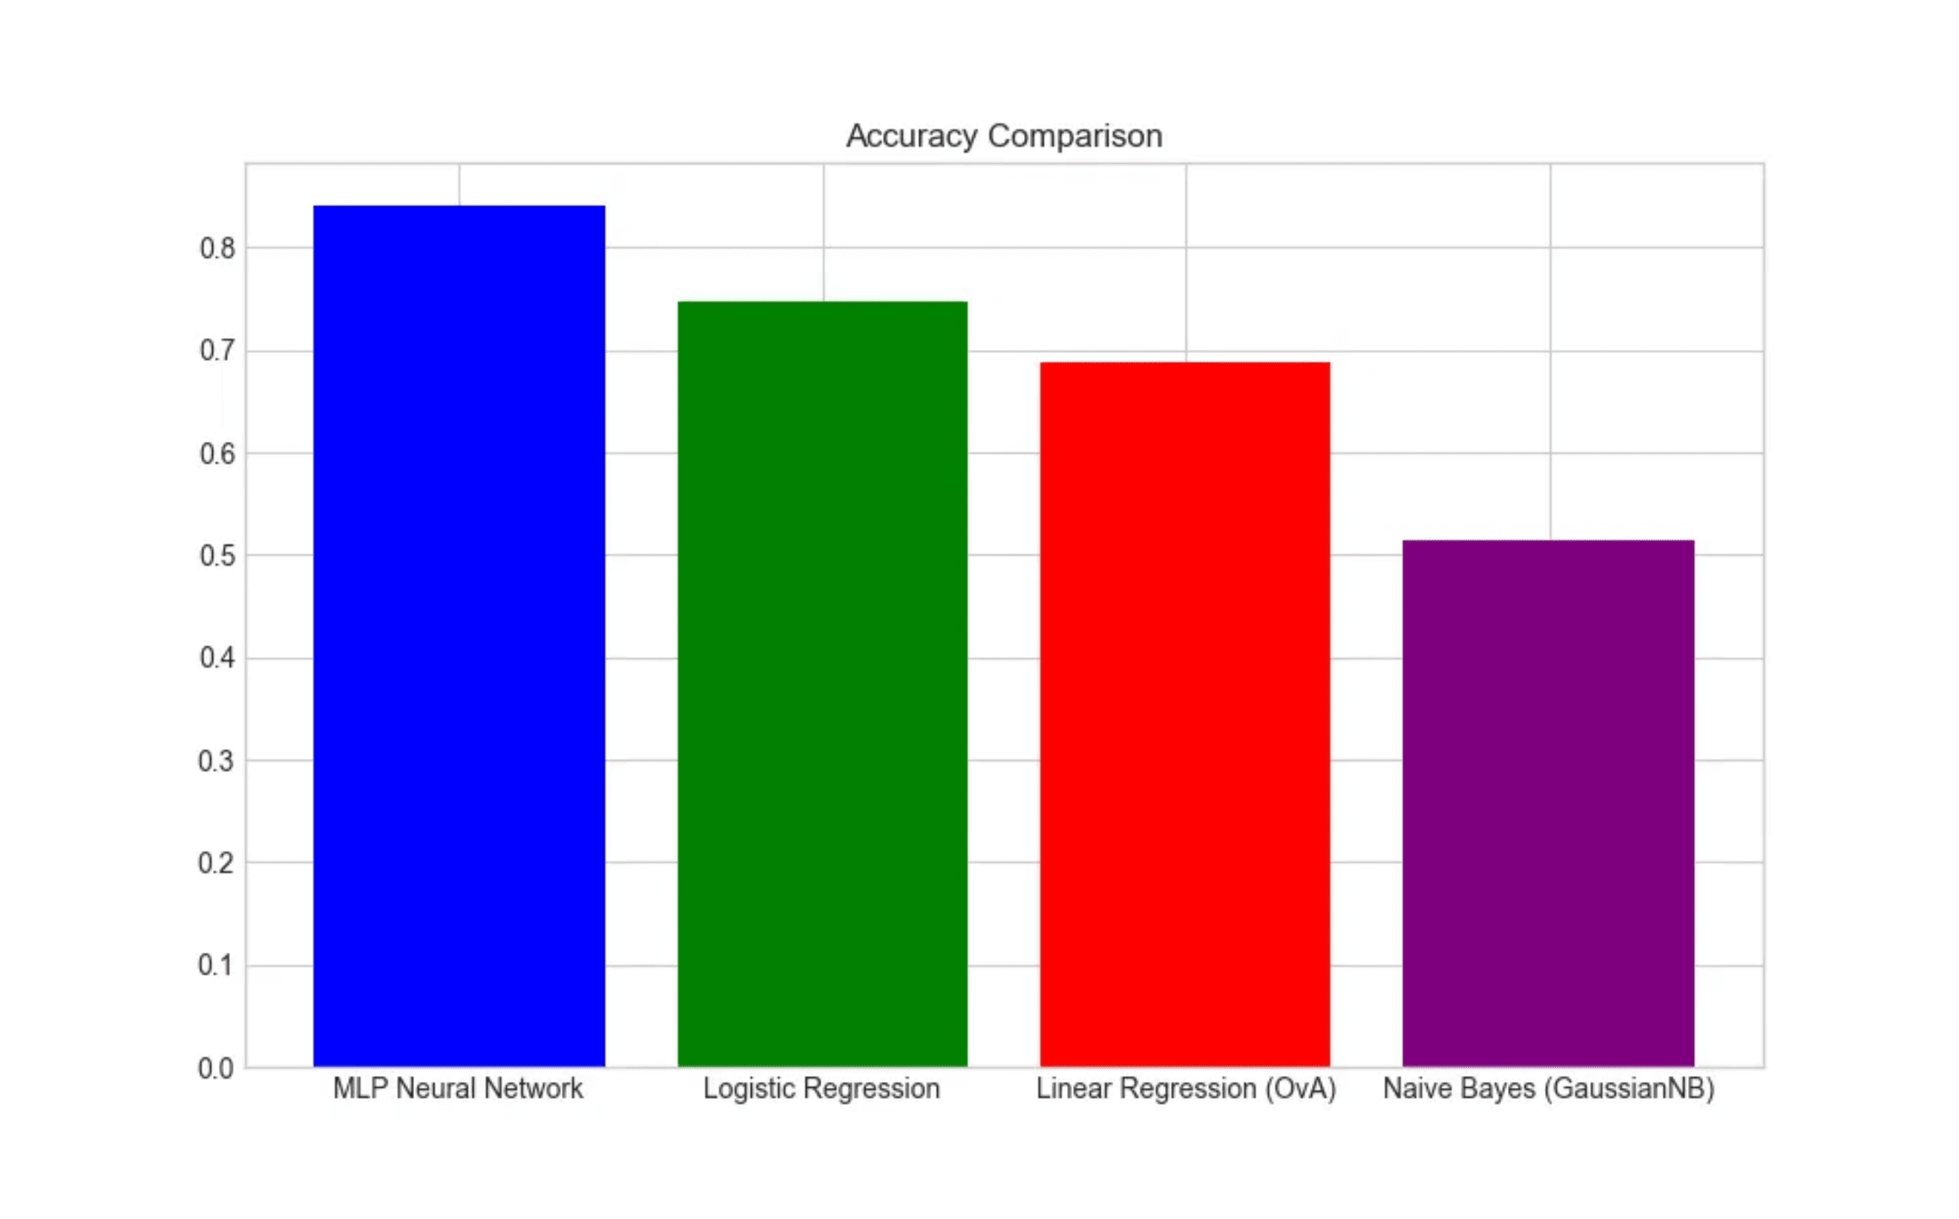
Results: Accuracy Comparison Visualized
MLP Superiority
The Multi-Layer Perceptron significantly outperforms all other models, achieving ~84% accuracy.
Linear Baselines
Logistic and Linear Regression show moderate performance, capturing basic linear patterns.
NB Limitations
Naive Bayes shows the lowest accuracy, highlighting the impact of the pixel independence assumption.

Slide 11
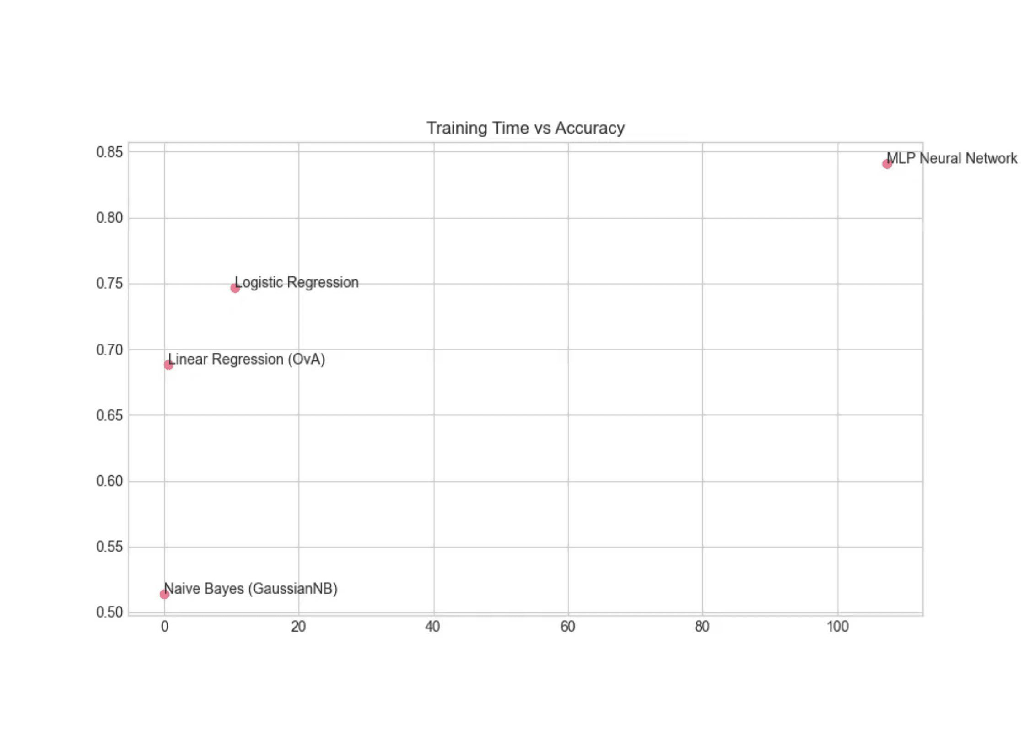
Results: Training Time vs. Accuracy
Computational Efficiency
Models like Naive Bayes and Linear Regression offer near-instant training (<1s) but suffer from lower predictive power.
The MLP Trade-off
The MLP Neural Network requires significantly more time (~107s) due to its iterative backpropagation process.
Conclusion: For this dataset, the 10% accuracy gain of MLP over Logistic Regression justifies the increased computational cost.

Slide 12

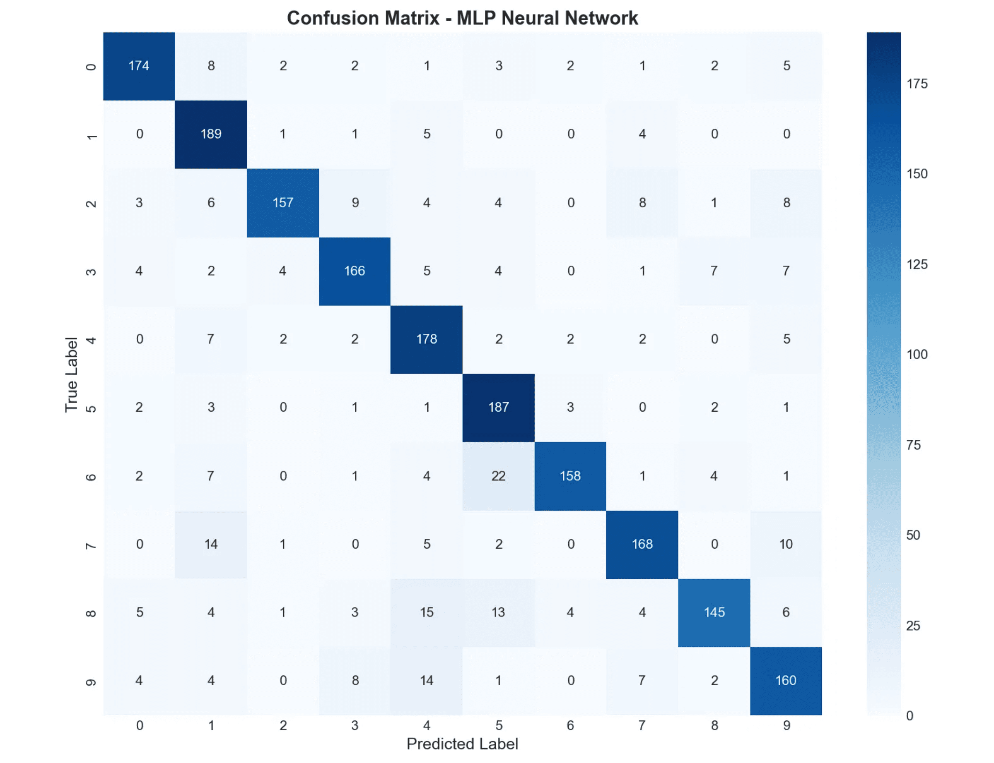
Results: Error Analysis via Confusion Matrix
Diagonal Dominance
High values along the main diagonal confirm the MLP's high accuracy across all 10 digit classes.
Common Errors
Minor misclassifications occur between visually similar digits, such as 4 and 9 or 3 and 8, where structural features overlap.
Model Robustness
The model maintains consistent performance without significant bias toward any specific digit, demonstrating effective feature extraction.

Slide 13

Model Superiority
Multi-Layer Perceptrons (MLP) are significantly better suited for image-based recognition tasks, achieving 84.1% accuracy compared to traditional linear baselines.
Key Takeaways
Methodology Impact
Rigorous data normalization and 5-fold cross-validation were critical in ensuring model stability and providing a reliable estimate of real-world performance.
Performance vs. Speed
While MLP requires higher computational resources, the substantial gain in predictive power justifies the increased training time for precision-critical applications.
The project successfully validated the efficacy of neural networks on the DIDA dataset, establishing a robust framework for handwritten digit classification.

Slide 14


